Slide 1
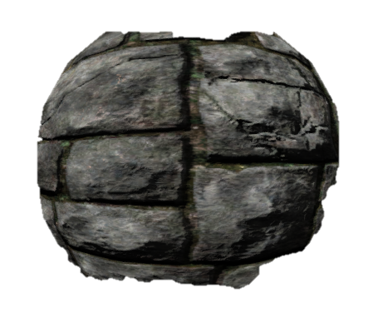
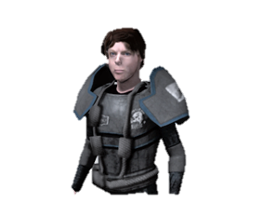
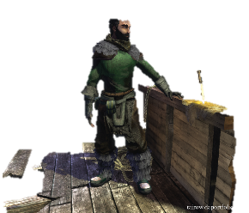
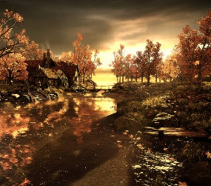
Global Explorer
Each Tile:
RequestTileImage();
Invoked when the full screen view is minimized
Returns an Image* (Invokes glFlush())
Materials
Models
Entities
Scenes
…
…

Slide 2
Drag Begin:
From: <Full Path>
Dragging:
From: <Full Path>
Drop:
From: <Full Path>
To: <Full Path>

Slide 3
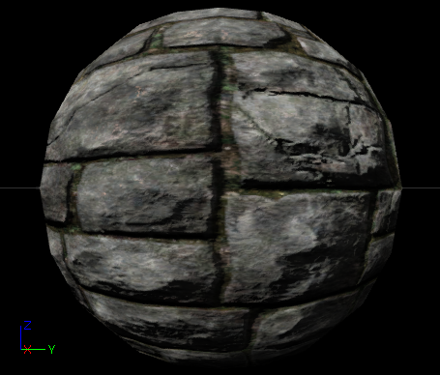
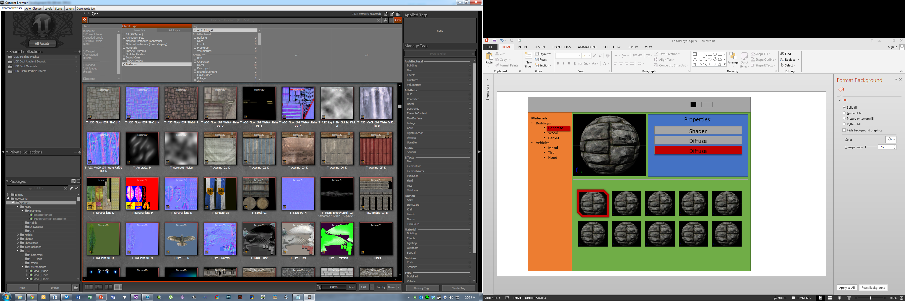
Material Editor
Textures
Building
Properties:
Specular
Diffuse
Normal
Bump

Slide 4
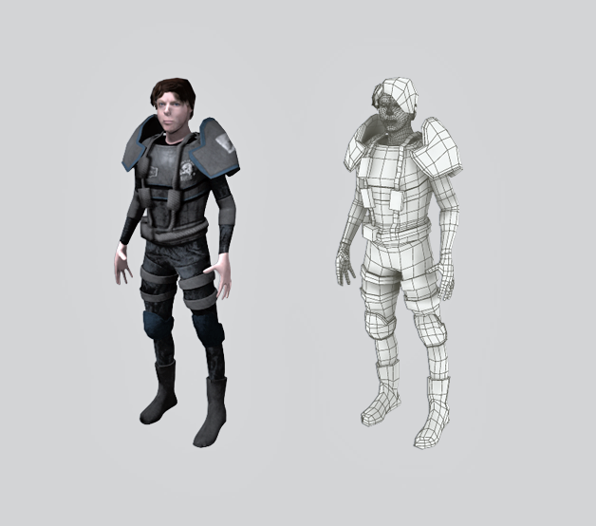
Model Editor
Models:
Male Soldier Character:
M4
Solder
House
…
Properties:
Textures
Building
Arm
Head
Leg
Materials:
Leg
Arm
Head

Slide 5
Entity Editor
Scene Graph:
Male Soldier Character:
Torso
Waist
Left Leg
Right Leg
Shoulders
Left Arm
Left Hand
Right Arm
Right Hand
Head
Left Arm [ Skinned Mesh ]
Transform
Skinning Properties
CharacterArmController.cs
SomeOtherScript.cs
+
Models
Characters

